Slide 1

Technology and society

Slide 2
Positivism – linear progress
Auguste Comte (1798–1857). The idea of linear progress in well defined stages.
Theological - Metaphysical - Scientific.
Theological. Supernatural forces explain events like thunder or drought.
Metaphysical. Explanations in unobservable phenomenon.
Scientific. Proper goal of science is simply the prediction of phenomena.

Slide 3
Marx
Marx used Hegels idea of thesis – antithesis = synthesis in the context of the development of history.
History is determined by the struggles between those who rule the modes of production and those who are under that rule.
On this basis it is possible to predict the course of history.

Slide 4
Determinism
Determinism: Determinism is true of the world if and only if, given a specified way things are at a time t, the way things go thereafter is fixed as a matter of natural law.
We ought to regard the present state of the universe as the effect of its antecedent state and as the cause of the state that is to follow. An intelligence knowing all the forces acting in nature at a given instant, as well as the momentary positions of all things in the universe, would be able to comprehend in one single formula the motions of the largest bodies as well as the lightest atoms in the world, provided that its intellect were sufficiently powerful to subject all data to analysis; to it nothing would be uncertain, the future as well as the past would be present to its eyes. The perfection that the human mind has been able to give to astronomy affords but a feeble outline of such an intelligence. (Laplace 1820)

Slide 5
Technological Determinism
Technology shapes how we as individuals in a society think, feel, act, and how are society operates as we move from one technological age to another. (Remember Kuhn’s view on science and the importance of the concept of paradigm.)
Technology defines history.
”The hand-mill gives you society with the feudal lord; the steammill, society with the industrial capitalist.” Marx, The Poverty of Philosophy

Slide 6
Themes
The Simultaneity of Invention (Tesla vs Edison)
The Absence of Technological Leaps (uniformitarianism vs catastrophism)
The Predictability of Technology
”To make a steam engine, for example, requires not only some knowledge of the elastic properties of steam but the ability to cast iron cylinders of considerable dimensions with tolerable accuracy.” (Heilbroner, 339)
The invention and getting to the market.

Slide 7
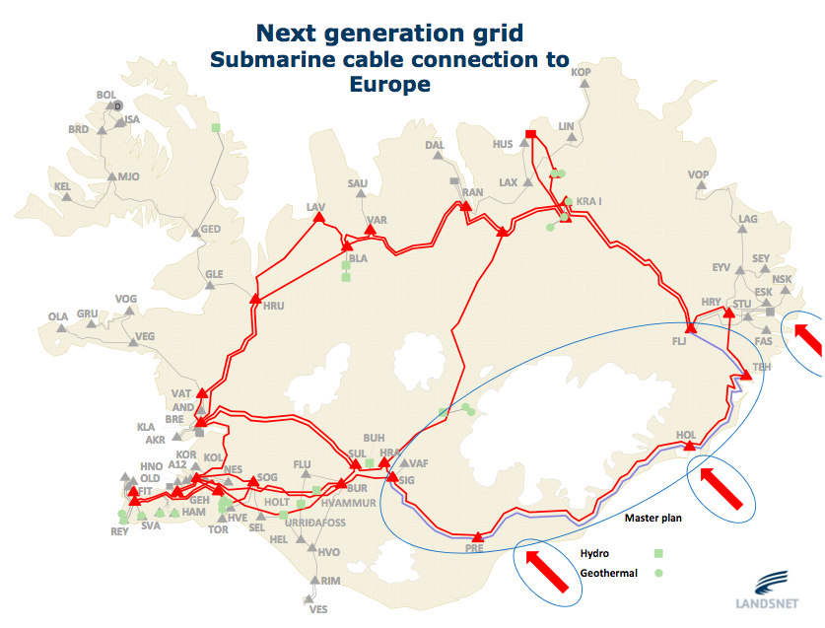
Technological systems
Electricity

Slide 8
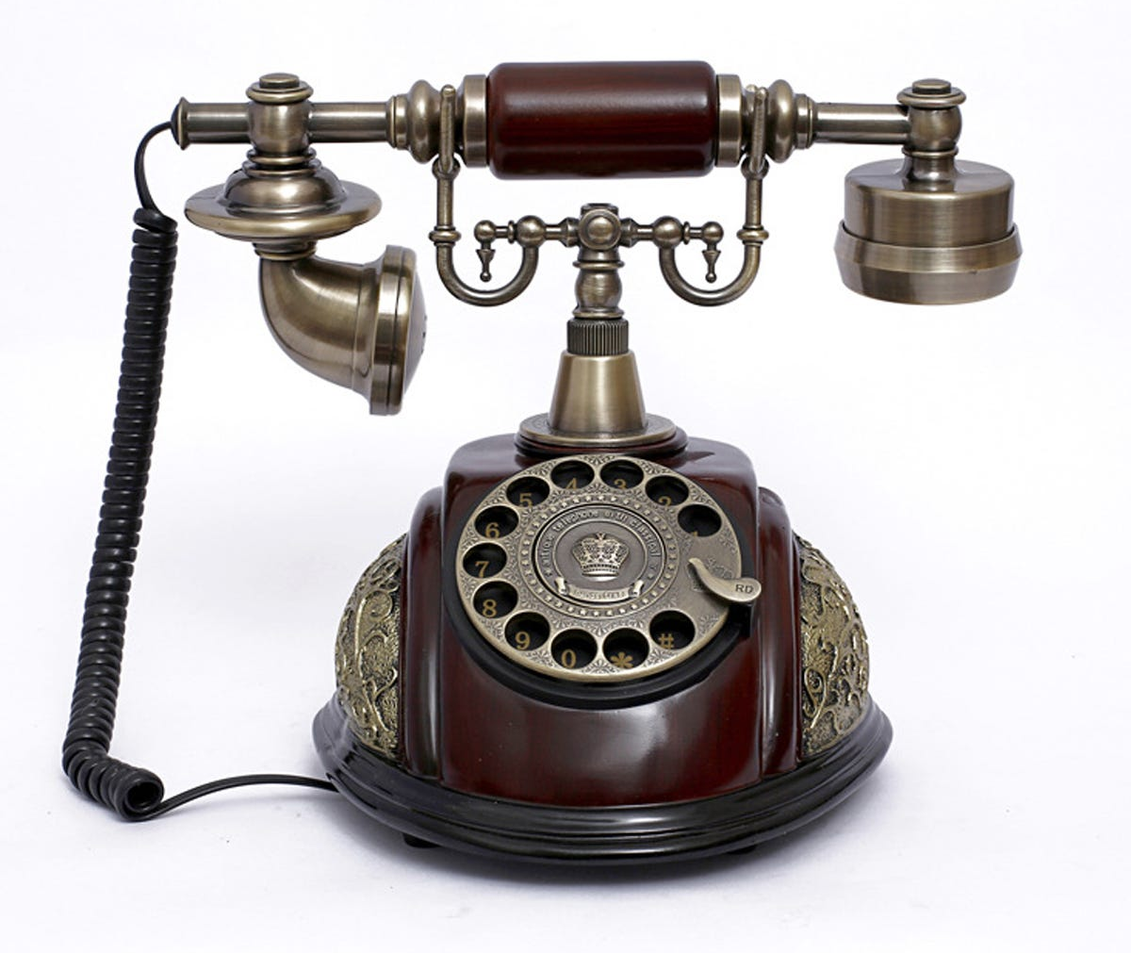
Phones In 1915, a three-minute daytime phone call from New York City to San Francisco cost 20 dollars

Slide 9
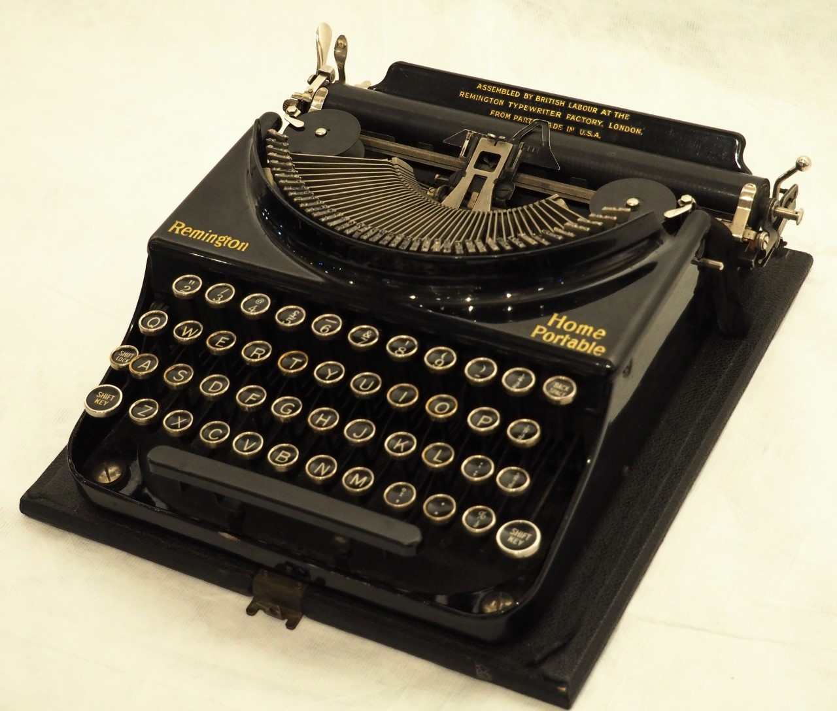
Qwerty The case of brilliant invention and race to market.

Slide 10
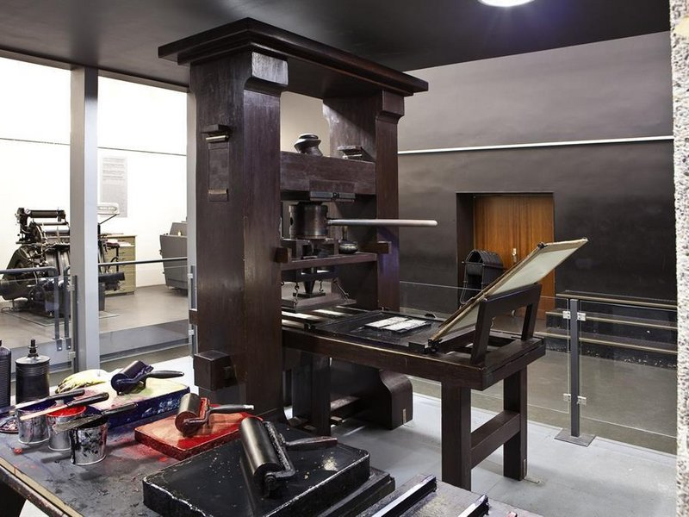
Guthenberg press
1440 Gutenberg in Germany his invention drastically changed society.
The establishment of the printer strengthened certain crafts such as copyists, book binders, gold- smiths, rubricators, illuminators, and miniature painters.
Printing offered a revolutionary way to publish. opportunities.

Slide 11
Impact on history
When Luther made his first public appearance in 1517, the art of book printing had been in existence for over half a century.
Catholic vs Lutheran.
Already in the years from 1517-1520, Luther was the most widely read and most influential writer on religious subjects in Germany.
One-third of a million copies of his works were spread throughout Germany between 1517 and 1520.

Slide 12



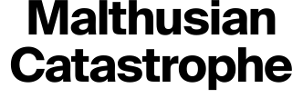





Slide 13


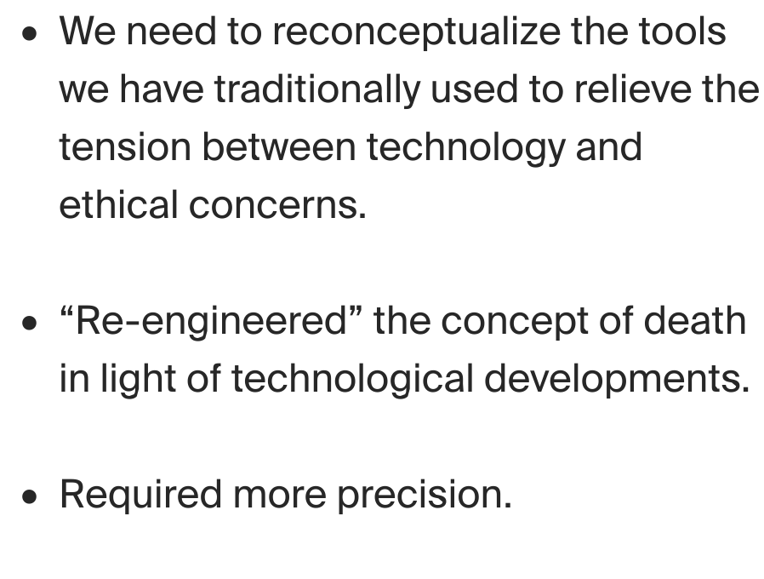
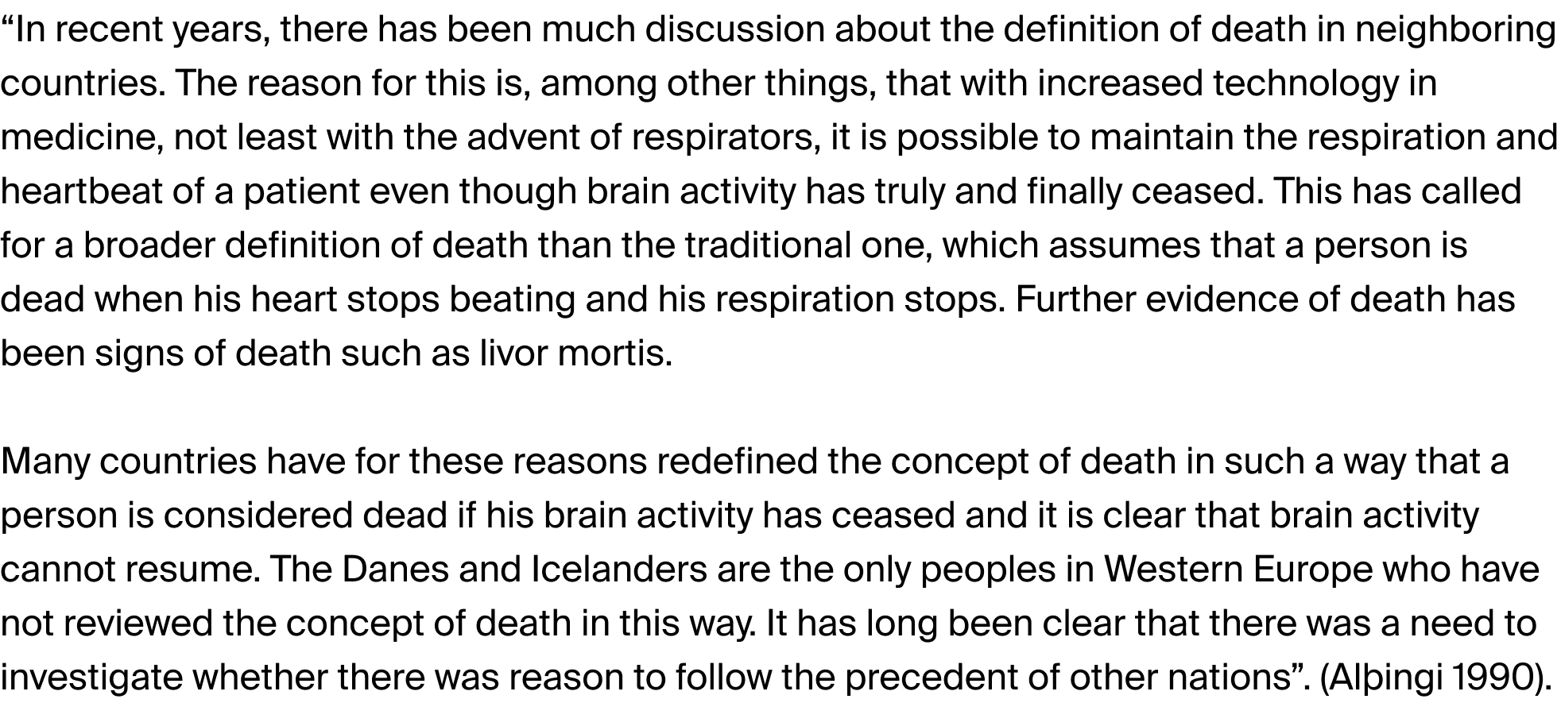

Slide 14











Slide 15





Slide 16






Slide 17
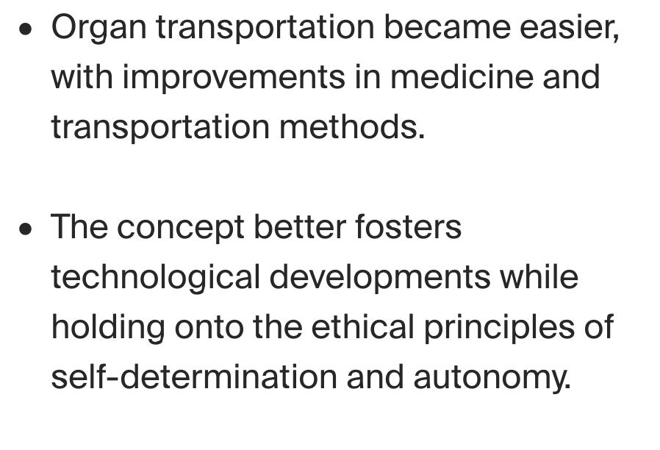
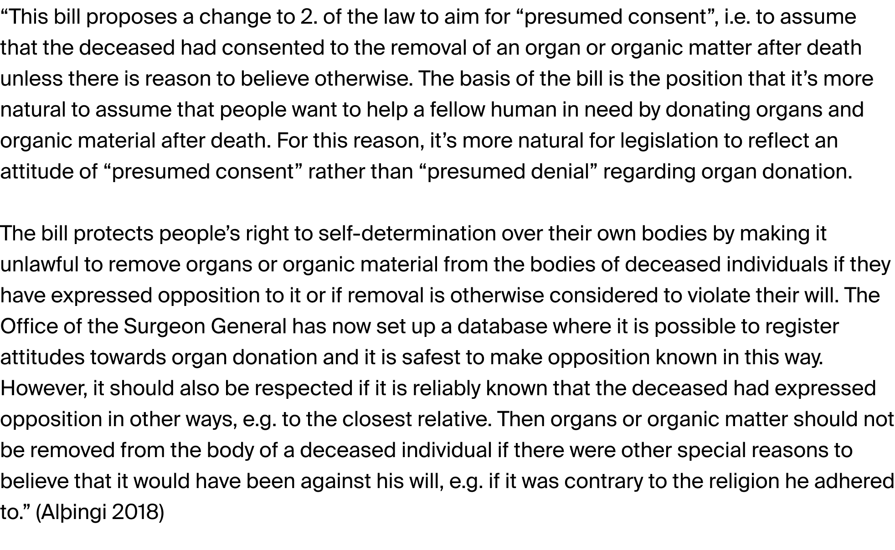

Slide 18
Autonomy and surveillance
The idea of autonomy in the age of the internet and social media.
Data collection and algorithms.
The processing of information about people and the use of AI.

Slide 19
Problems with AI
How is AI developed?
What biases come with the AI?
How do we get around these problems?
The importance of open AI.

Slide 20
Impact on people
In order to conclude on policy issues regarding the use of data collections and algorithms there needs to be an understanding on the use of algorithms and aims.
These mechanisms are having a huge impact on our lives. Positive and negative.

Slide 21
Social factors
Pressure in research.
Money.
Vulnerable groups.
Technological advancements.
Media and government.

