Slide 1
Technology and Society

Slide 2
Technology
Episteme (knowledge) and techne (craft/art)
Theory and practice
Scientific method (logical rules) vs rules of thumb (insight)
Knowing that (propositional knowledge) and knowing how (non-articulated knowledge/tacit knowledge)

Slide 3
Technology
Technology imitates nature
Technology can produce things nature cannot. Aristotle “generally technè in some cases completes what nature cannot bring to a finish, and in others imitates nature”
Natural and artificial - „Natural products (animals and their parts, plants, and the four elements) move, grow, change, and reproduce themselves by inner final causes; they are driven by purposes of nature. Artifacts, on the other hand, cannot reproduce themselves.“
Technology - instrumentality and productivity
  Instrumentality - control of life and environment
  Productivity - invent new things to achieve something

Slide 4
Technology
Relationship between Science and Technology
  Is technology applied science?
  What about the impact of technology on science?
Ontology
  Science: How things are? (Actuality)
  Technology: How things ought to be? (Possibility)

Slide 5
Technological progress
Bacon in the Novum Organum: „Again, it is well to observe the force and virtue and consequences of discoveries, and these are to be seen nowhere more conspicuously than in those three which were unknown to the ancients, and of which the origin, though recent, is obscure and inglorious; namely, printing, gunpowder, and the magnet. For these three have changed the whole face and state of things throughout the world; the first in literature, the second in warfare, the third in navigation; whence have followed innumerable changes, insomuch that no empire, no sect, no star seems to have exerted greater power and influence in human affairs than these mechanical discoveries.“

Slide 6

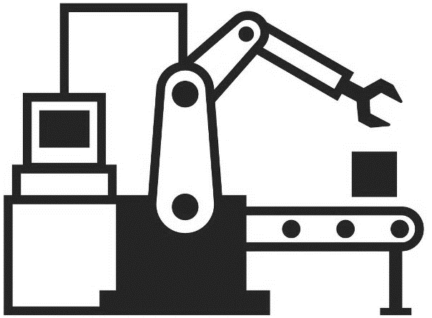
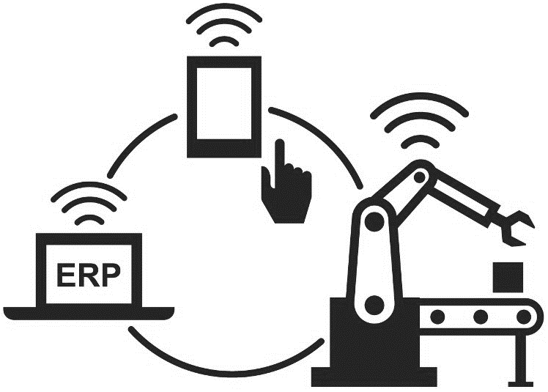
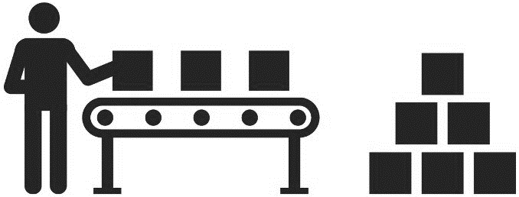
Industrial revolutions
First (steam power) 1760-1870
Second (electricity) 1870-1970
Third (information technology) 1970-2010
Fourth (artificial intelligence) 2010-

Slide 7
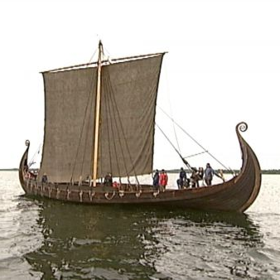
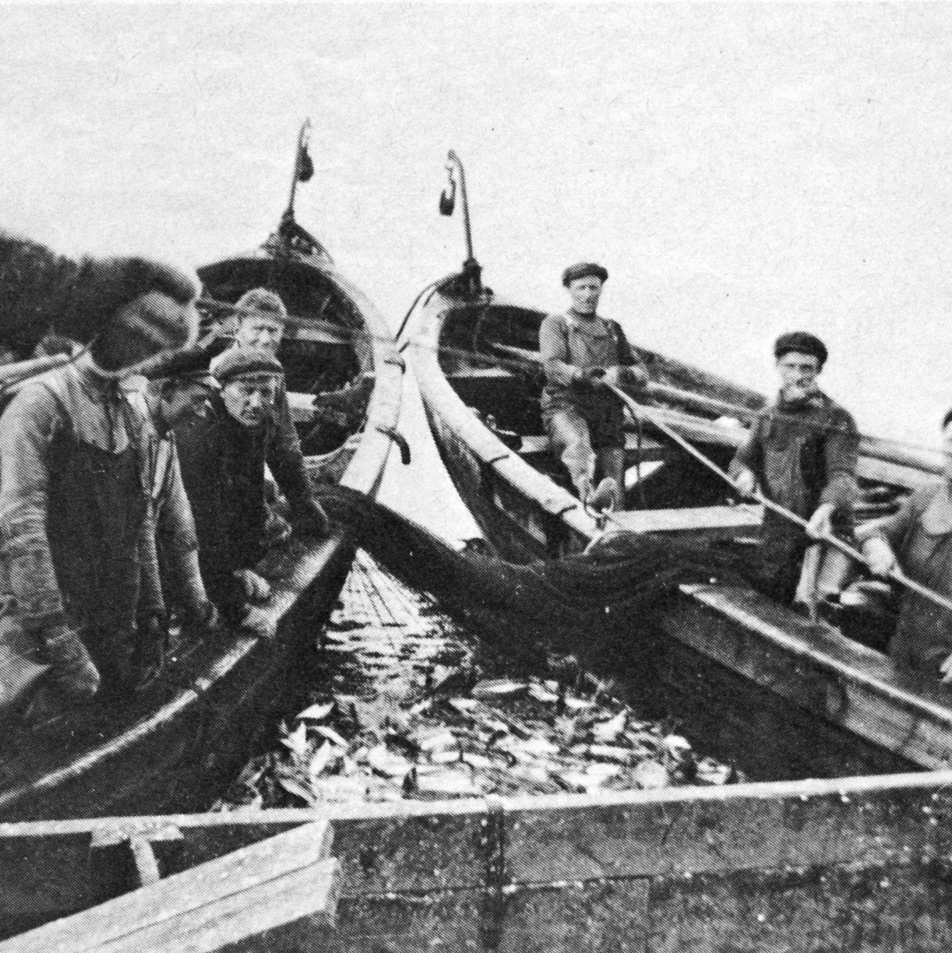
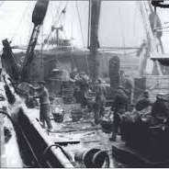
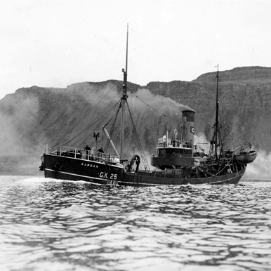
Technological advancement

Slide 8
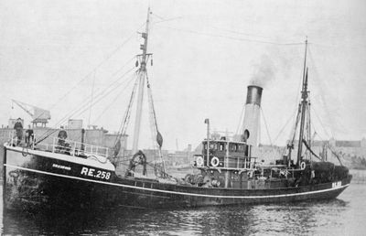
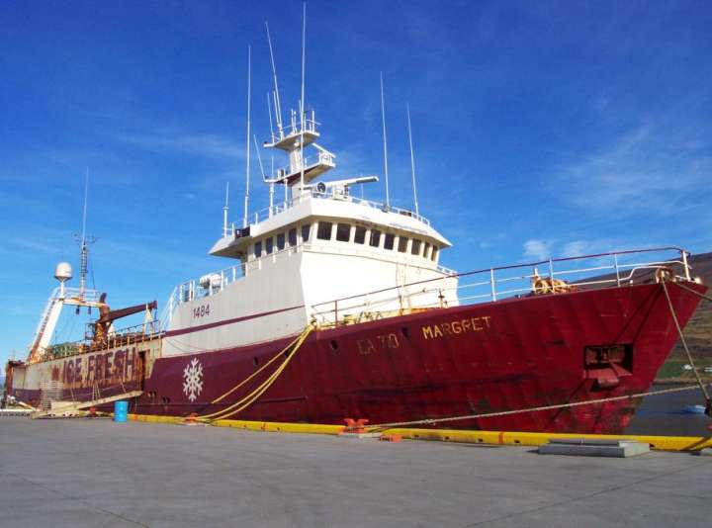
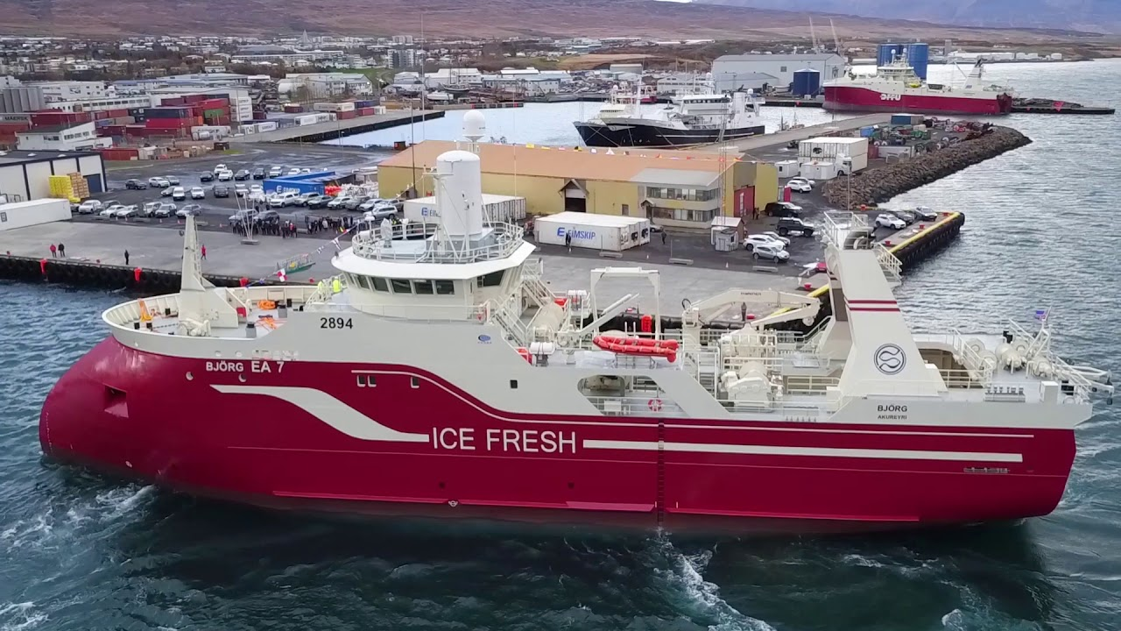

Slide 9
Changes in the labour market in Iceland are well known.
Jobs in fisheries and agriculture have dropped from over 80% of the labour market down to under 15% in the last 100 years.
Jobs in services have taken over.
Seafood sector still of great importance in terms of export.

Slide 10
Fewer jobs
In the traditional fishing sector there are fewer jobs.
In high-tech fishing sector we have an increase in job.
Big difference between the sectors in terms of skills required.

Slide 11
Technological advancement and fisheries
Industrial revolutions have had a huge impact on fisheries.
The first and second revolutions increase the total catch and how far ships can go.
The third increases the amount of data about the industry.
The fourth is about quality and better production.

Slide 12
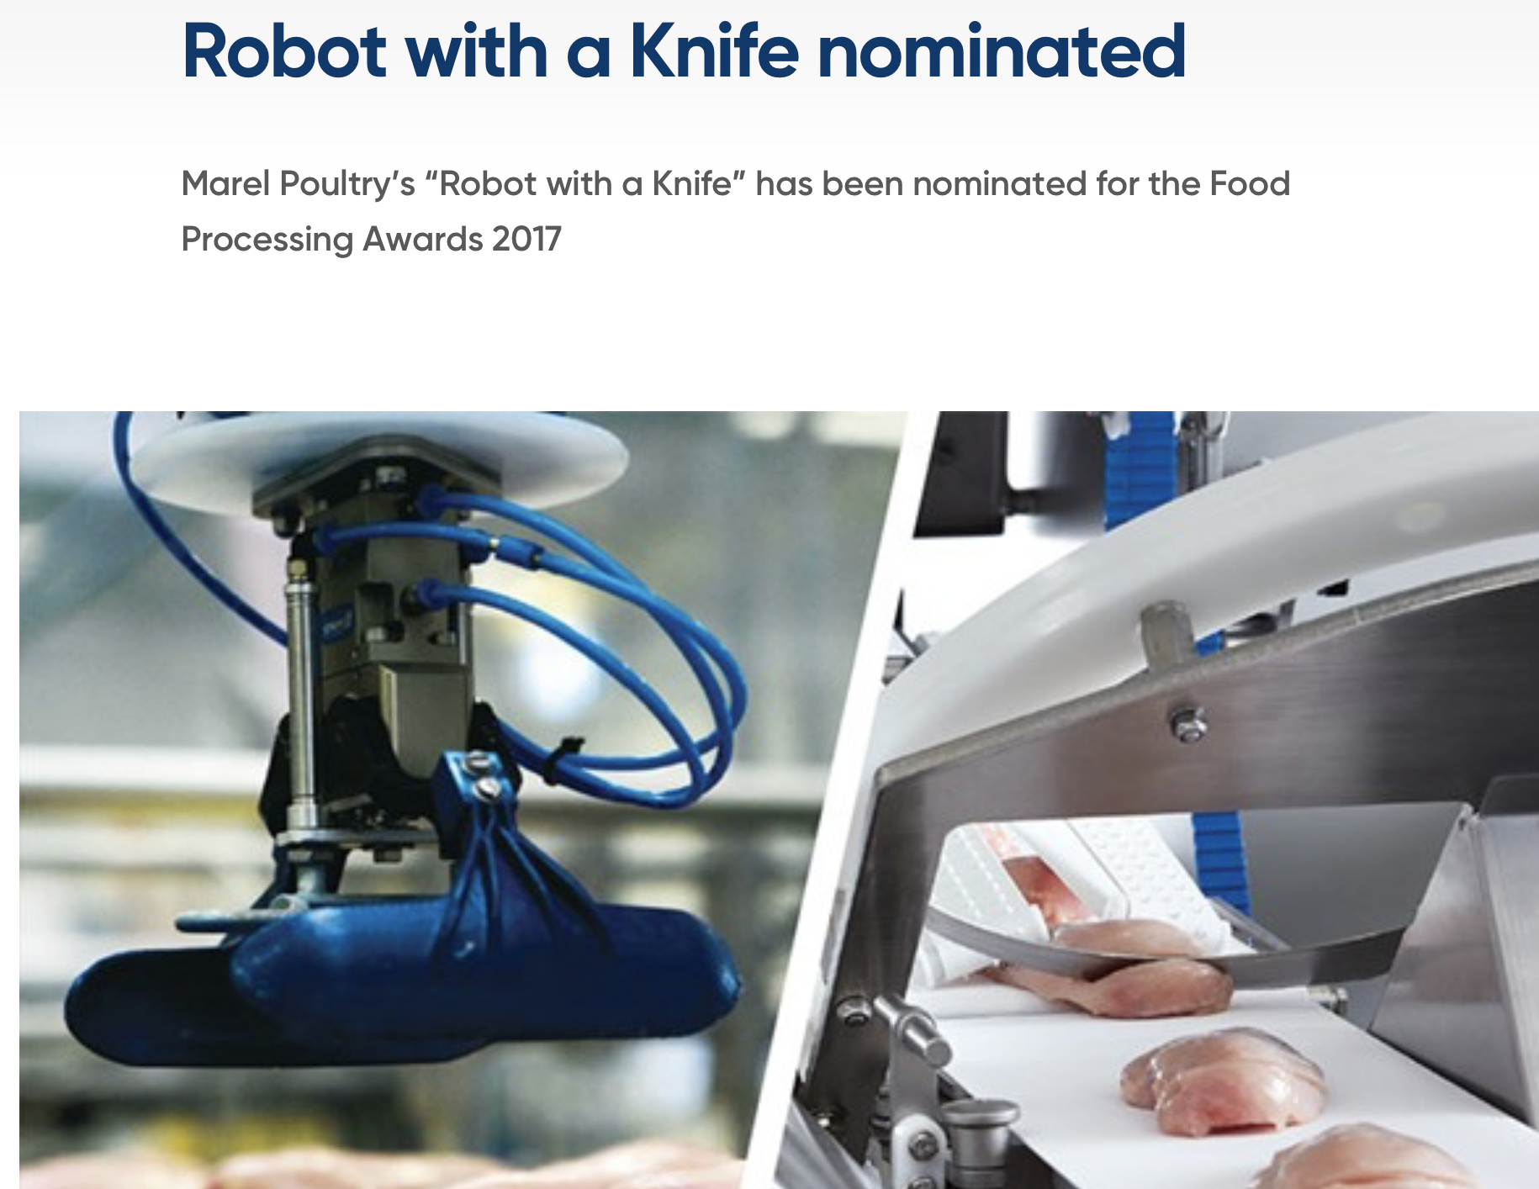
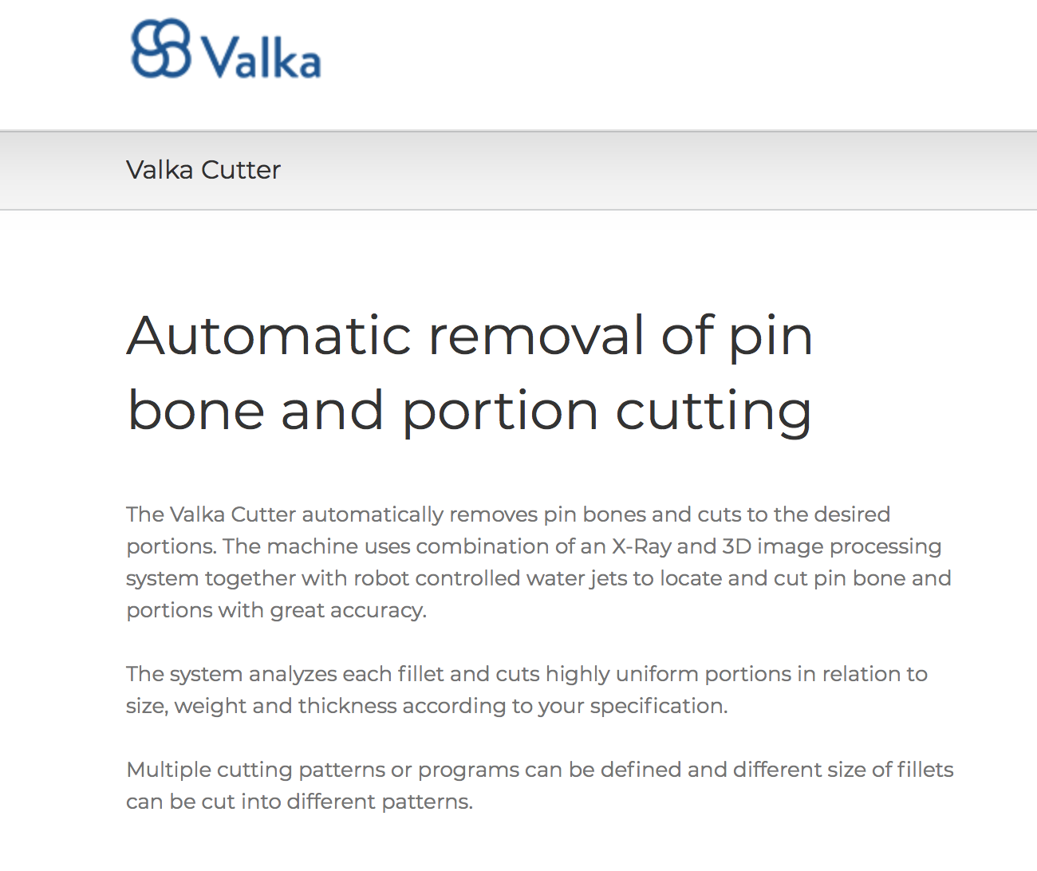
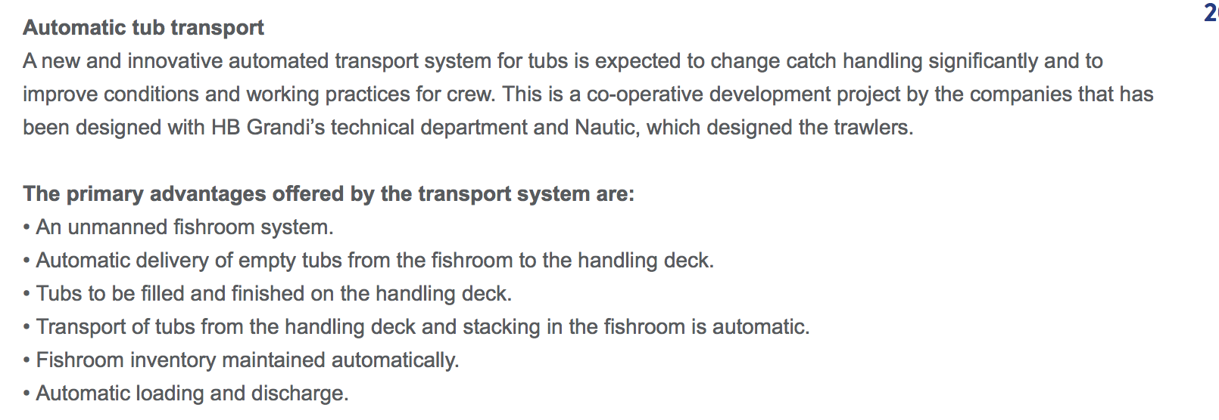
Seafood sector
Technological advancement within the seafood sector.
Increased competitiveness (Machine vs. Labour).
Better results in processing (impact on pricing)
Use in other food sectors.

Slide 13
Disruption
Rural areas vs. high tech development.
Shift in jobs. Traditional jobs automated but increase in high tech jobs.
Competition with labour in other countries.
Change of relation with consumer.
Disruption of the traditional value chain.

